Slide 1
JVM Basic Memory Management Garbage Collection Multi Thread

Slide 2
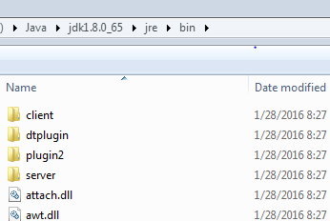
JVM Location Path
%JAVA_HOME%\bin\java.exe
%JAVA_HOME%\bin\javaw.exe
%JAVA_HOME%\bin\javaws.exe
%JAVA_HOME%\jre\bin\client\jvm.dll
%JAVA_HOME%\jre\bin\server\jvm.dll
Launcher
Argument to start:
-client start quickly, save memory
-server heavy, use much optimization for
long-time running

Slide 3
JVM Version
java –version
java version “1.7.0_67”
Java(TM) SE Runtime Environment(build 1.7.0_67-b01)
Java HotSpot(TM) Server VM(build 24.65-b04,mixed mode)
java –client –version
java version “1.7.0_67”
Java(TM) SE Runtime Environment(build 1.7.0_67-b01)
Java HotSpot(TM) Client VM(build 24.65-b04,mixed mode)

Slide 4
JVM Options
standard -
all jvm must support
ex: -version -jar
optional -X
ex: -Xms -Xmx
optional and unstable -XX:
no description in document, no notification if disappear.
total 700+ production 300+
ex: -XX:+PrintGC -XX:OldSize=100m

Slide 5

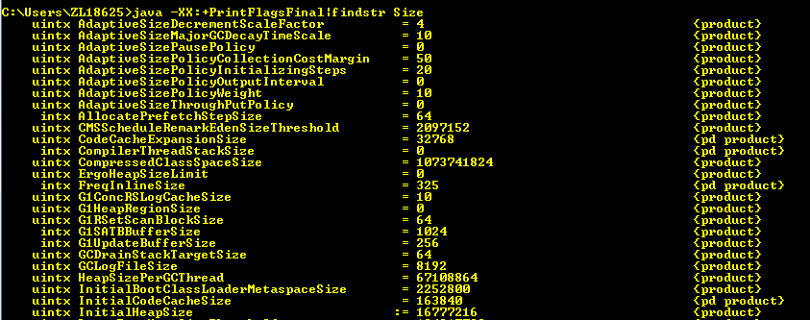
JVM Options
Print one or more arguments
Java –XX:+PrintFlagsFinal | findstr

Slide 6
Compilation
Java -Xint interpreted mode
Java -Xcomp compiled mode
Java -Xmixed mixed mode (default)
two times of compilation:
1. javac
2. JIT ( Just In Time ) – Dynamic Compilation

Slide 7
HotSpot-JIT
Method
Basic Unit Of Compilation
server 10000
client 1500
-XX:CompileThreshold
Invocation Counter
Count by times of execution
Back Edge Counter ( loop )
CounterDecay - If an application has running for a long time, in theory,
all methods will be over threshold.
HotSpot introduces CounterDecay, if the counter has
not been up to threshold in a certain time, it will be
reduced by half.

Slide 8
OSR- On Stack Replacement
intepret/run
method
(.class)
reach threshold?
no
yes
loop/recall
JIT
OSR
VM Pause
machine
code

